Slide 1

Python for Business Analysis

Slide 2
Suggestions to improve this year’s performance
1
Data Preparation
2
Table of Contents
Which Category and Item sells the most ?
3
Focus on a Niche
4
Sales and Earnings
5
Top 10 Country/Region/State with the most orders
6
Customer Traffic & Discounts
7

Slide 3
Suggestions to improve this year’s performance
Data Source consists of a database with these notable tables...
Customer Data
Main Table
Order Data
Product Data
Shipping Data

Slide 4
Data Preparation
Query for the best-selling product category and the individual products.
Find what areas of shipping and handeling needs improvement
Where are the majority of customers located and finding trends and habbits their order history.

Slide 5


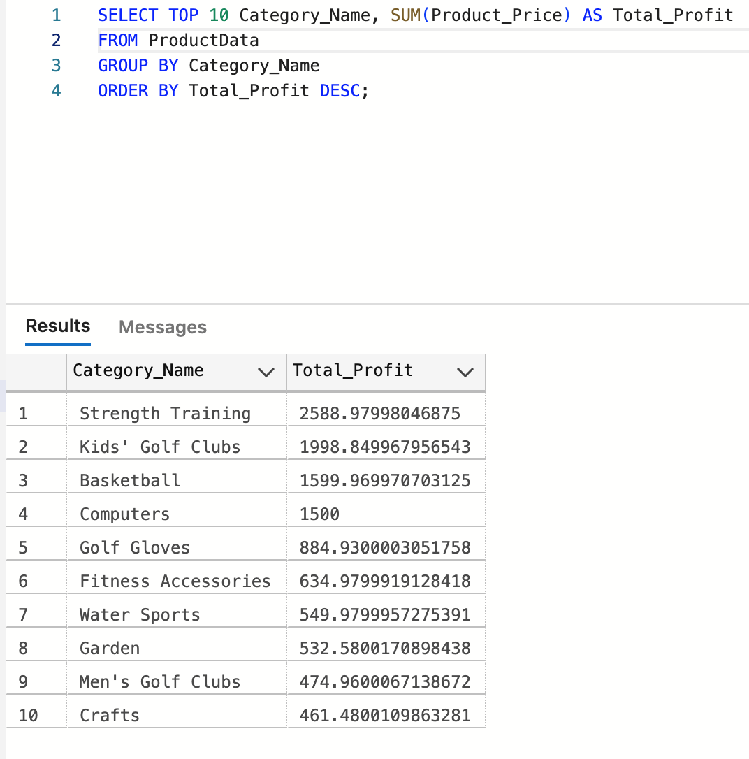
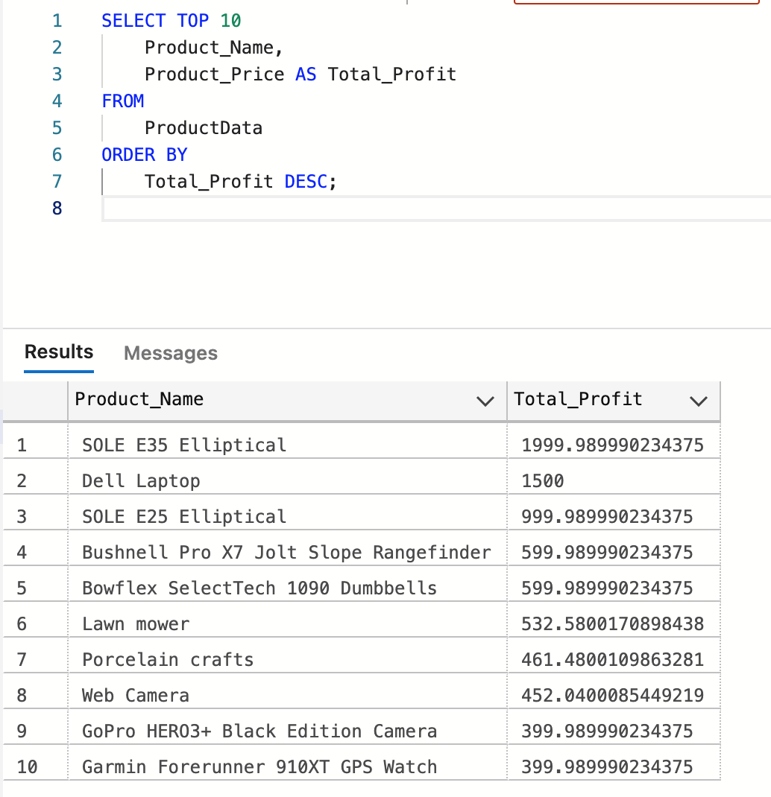
Which Category and Item sells the most ?

Slide 6

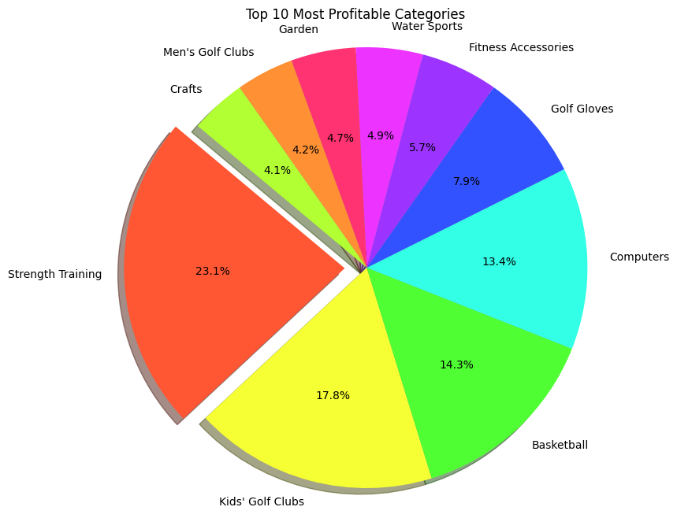
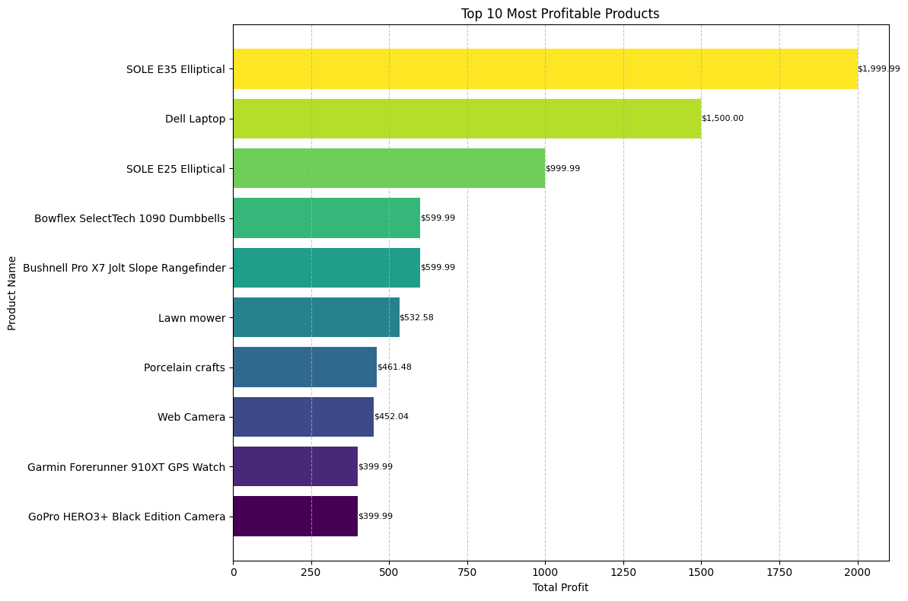
Which Category and Item sells the most ?
Comparison among the Categories showing the most Profitable​
Top 10 Most Profitable items in that Category to Narrow down our Sales ​

Slide 7
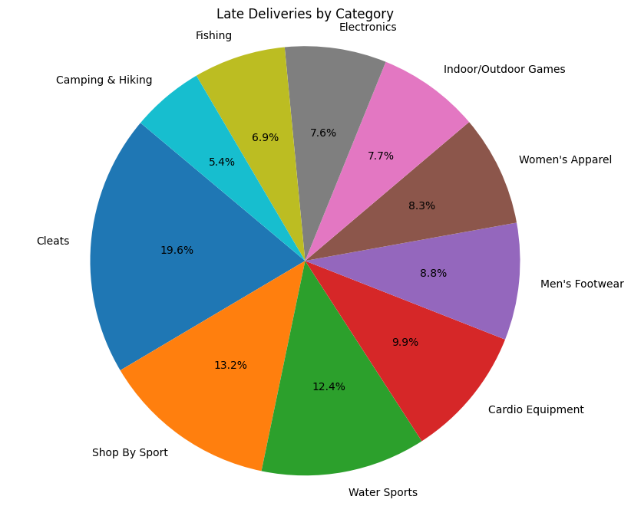
Focus on a Niche
6 of the top 10 most profitable product are related to sport gear or gym equipment.
Nearly 80% of the profitable categories relate to sports related activities
75.1% of the product categories that have the consistent late deliveries are sport related products.
Given these related categories
A suggestion to focus on improving delivery on these product on a timely manner would improve customer retention and brand cohesion.

Slide 8
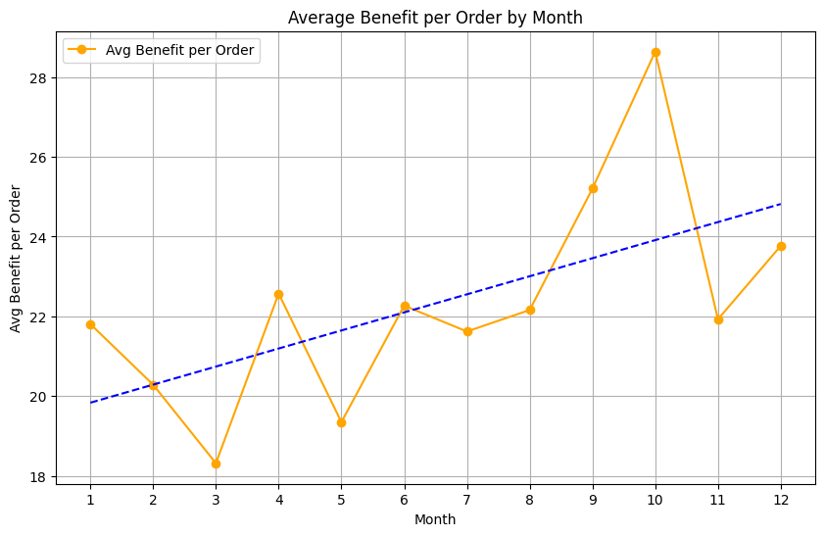
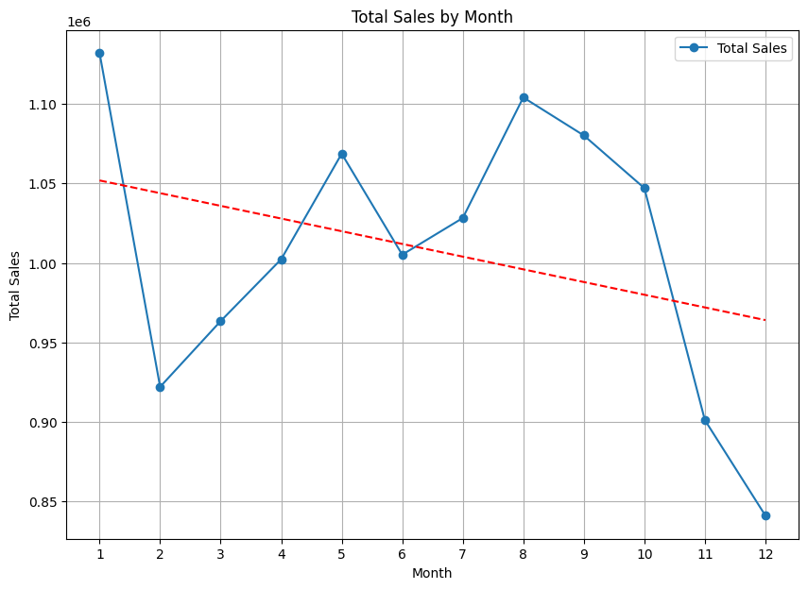
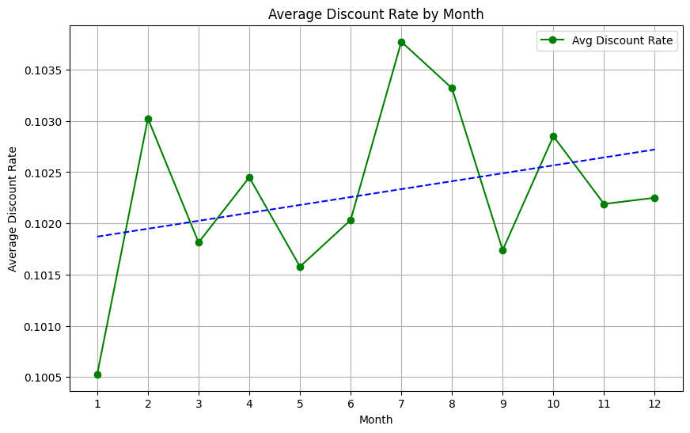
Sales and Earnings
Despite January having the largest sales, it does not have the most earnings per order, that goes to October.
This implies sales does not equate to real earning per order.
There is a correlation to the average discount rate given each month.
Notes:
SELECT
Customer_Segment,
COUNT(DISTINCT Order_Id) AS Total_Orders,
SUM(CAST(Order_Item_Total AS DECIMAL(18, 2))) AS Total_Sales,
AVG(CAST(Order_Item_Total AS DECIMAL(18, 2))) AS Avg_Order_Value
FROM CustomerData
INNER JOIN OrderData ON CustomerData.Customer_Id = OrderData.Order_Customer_Id
GROUP BY Customer_Segment;

Slide 9

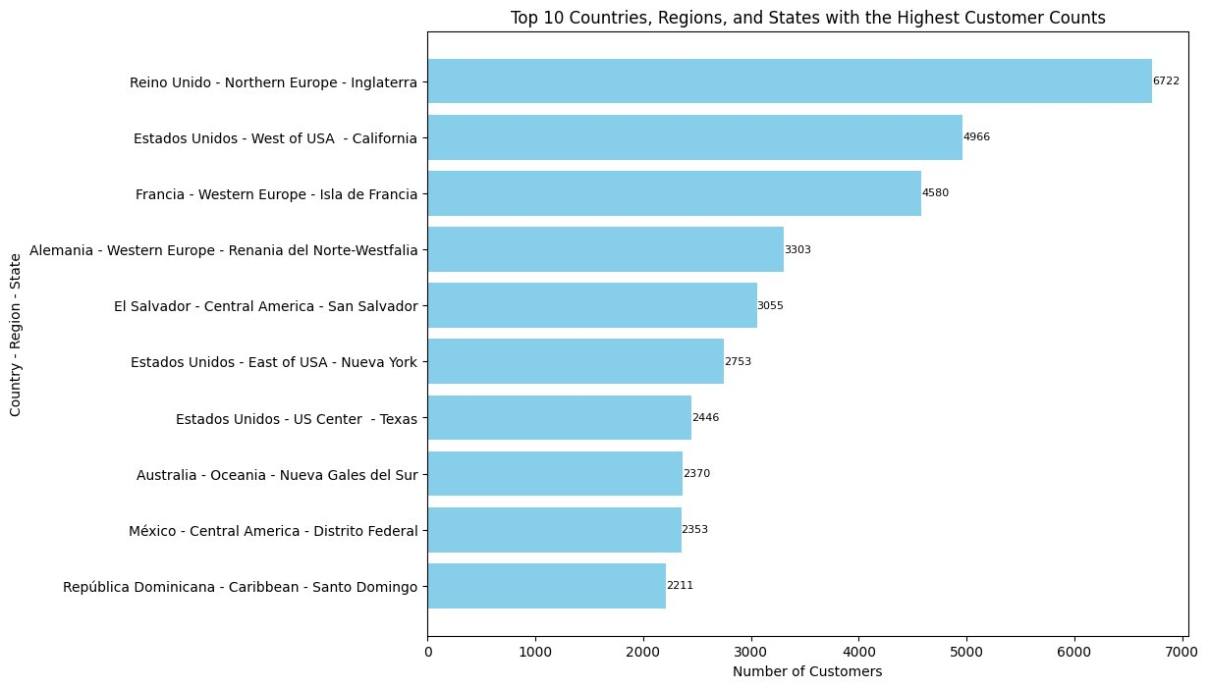
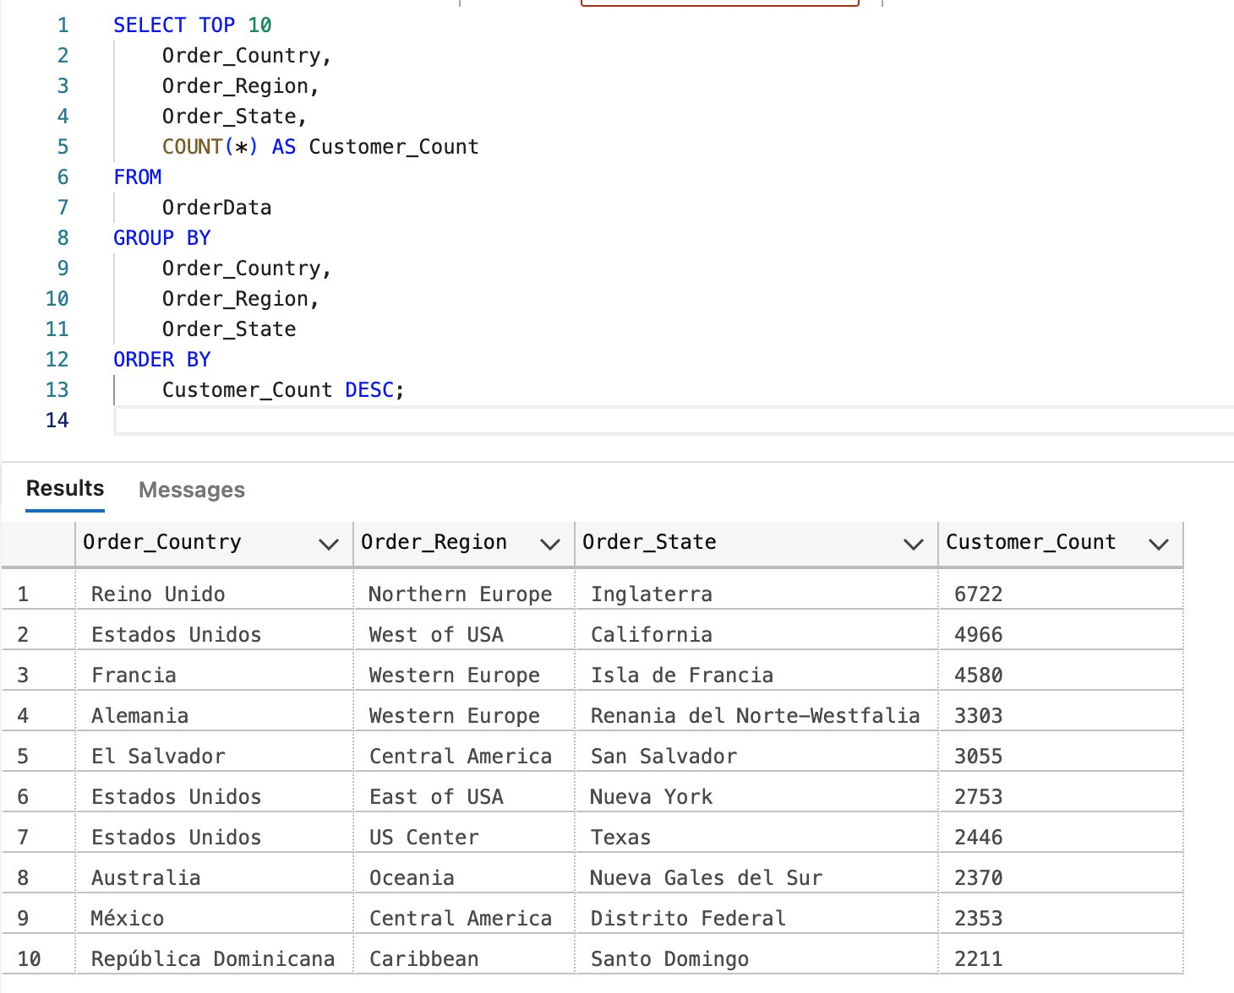
Top 10 Country/Region/State with the most orders

Slide 10
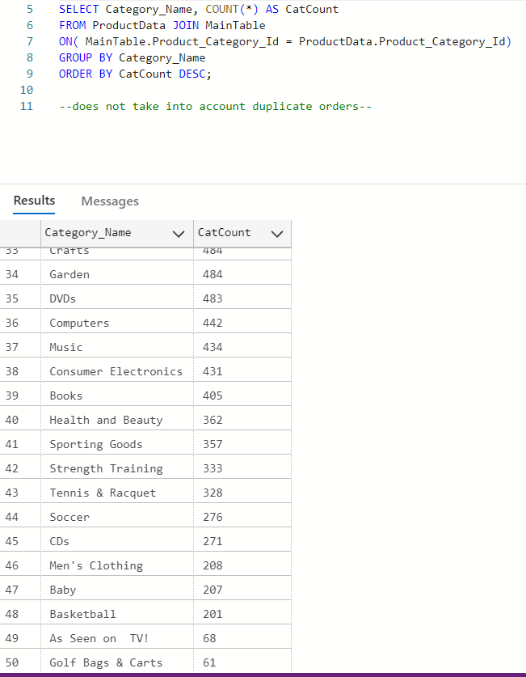
Customer Traffic & Discounts
Based on the time of the day when there is the highest customer traffic, offer (timed) discounts for the category of items that are not selling as much in numbers.
Notes:
Categories that do not sell in many numbers can possibly see an increase with the timed discounts. E.g., flash sales during the time of the day when there is the most foot traffic.

Slide 11
Conclusion

Slide 12


